Slide 1

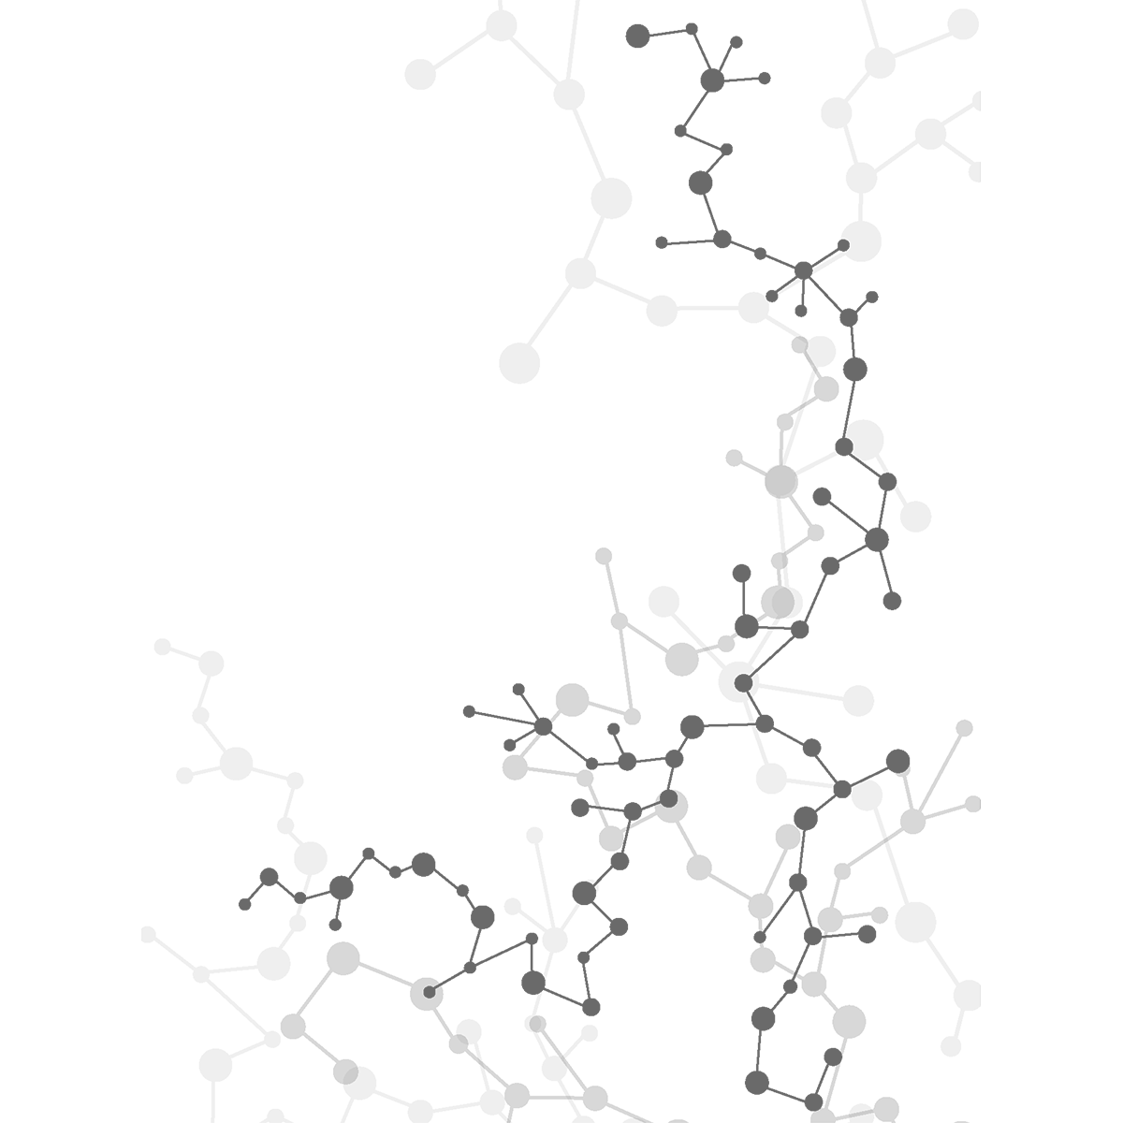

Virtual Workshop 1 September, 2020
Presented by AI@Penn

Slide 2
Introduction
Purpose: equip students with ability to harness AI technology, and apply it to real-world scenarios – business, financial, healthcare, etc.
Workshop approach: learn how an algorithm works, understand the basics of a data pre-processing tool and apply the knowledge to a real life dataset.

Slide 3
Quick Note
Fill this out: https://forms.gle/PsBLF5cApFisAv4g8
Stay notified about workshops, speakers, etc.

Slide 4
Overview of Coming Weeks
Session 1: SVMs + K-Nearest Neighbours (Social Media Ad Success)
Session 2: Logistic Regression (Credit Default Prediction)
Session 3: Linear Regression (Real Estate Valuation)
Session 4: Neural Networks (News Outreach)
Session 5: LSTM Networks (Stock Price Prediction)
Intersperse with guest presentations, practical project sessions (e.g. OpenCV, iPhone applications, recommender systems).

Slide 5
Today’s Plan
Learn about the core, underlying approach of Machine Learning
Set up programming environment - Google Collab
Gain intuitive insight to SVM + KNN algorithms
Program them

Slide 6
AI & ML (I)
Machine Learning uses statistical techniques to give computer systems the ability to "learn" (i.e., progressively improve performance on a specific task) with data, without being explicitly programmed.
Artificial Intelligence is the theory and development of computer systems able to perform tasks normally requiring human intelligence, such as visual perception, speech recognition, decision-making, and translation between languages.
ML ⊆ AI

Slide 7
AI & ML (II)
Why now? → more data, greater CPU power, better algorithms
Subfields + Applications: Computer Vision (medical image diagnosis), Natural Language Processing (chatbots), Boltzmann Machines (recommender systems), GANs (image/video generation)

Slide 8
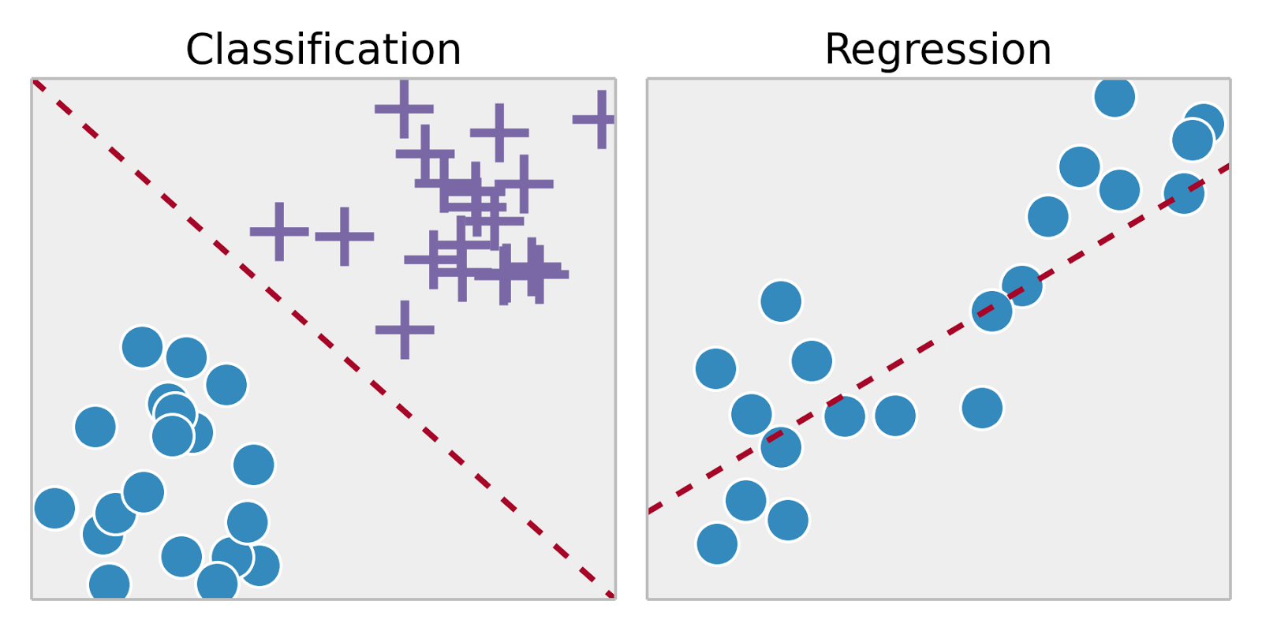
Types of Approaches
Supervised: labelled data (e.g. house prices), Unsupervised: unlabelled data (e.g. bank customer data)
Classification: predicting discrete outcome (eg. handwritten digit), Regression: predicting continuous outcome (eg. house prices).
Classification requires distinct sets, and each piece of training data must belong to one.

Slide 9
Approaching Supervised Tasks
Compile/find dataset (data wrangling) → example social media advertisement success dataset (instances, features, output value, predicted value)
Pre-process data
Explore data
Create algorithm framework
Feed data from dataset to algorithm using training data (training phase)
Evaluate performance of algorithm using test data (testing phase)

Slide 10
Programming Environment
Google Collab: https://colab.research.google.com/
New Python 3 notebook
Allows for note-taking on the document
Efficient running of programs
Inbuilt libraries

Slide 11
K-Nearest Neighbours
Choose k number of neighbours (usually around 1 per 100 data points, or just 5)
Plot new test data point on graph that has all training points
Take the k nearest neighbours according to distance metric (eg. Euclidean, Manhattan)
Among the k neighbours, count the number of data points in each category
Assign new data point to category with most neighbours

Slide 12
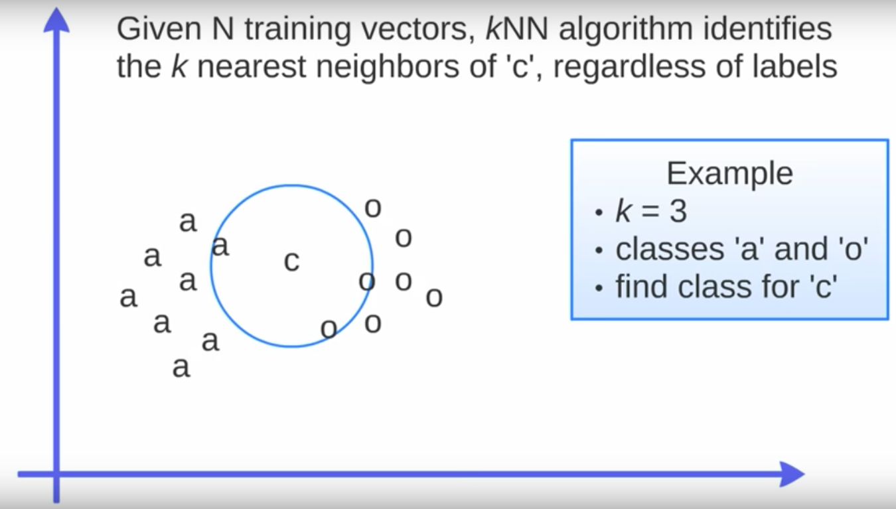
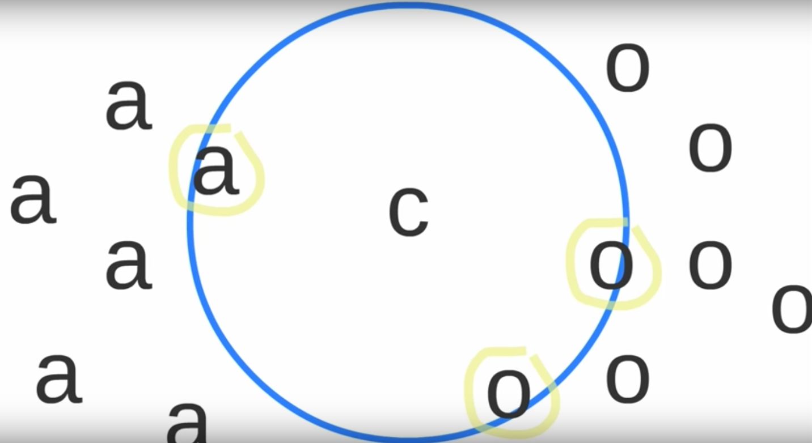
KNN Visualization

Slide 13
Support Vector Machines (I)
Find the dividing hyperplane that splits the classes with the maximum margin.
Maximum margin is measured by the distance between the two ‘closest’ points from each class, which are known as the support vectors.
Hyperplane for each support vector constructed using parallel lines to the dividing hyperplane, that pass through each support vector.
Find distance between support vector hyperplanes → subtract y-intercept.

Slide 14
Support Vector Machines (II)
Minimizing this distance involves optimization, which is solved by the Karush-Kuhn-Tucker (KKT) conditions, using Lagrange multipliers.
If all points cannot be classified by a dividing hyperplane (i.e. the support vectors fall on the same side), we can penalize this differently.
For example, we create the hyperplane that divides the maximum number of , and make our support vectors the ones furthest from their ‘original’ side.

Slide 15
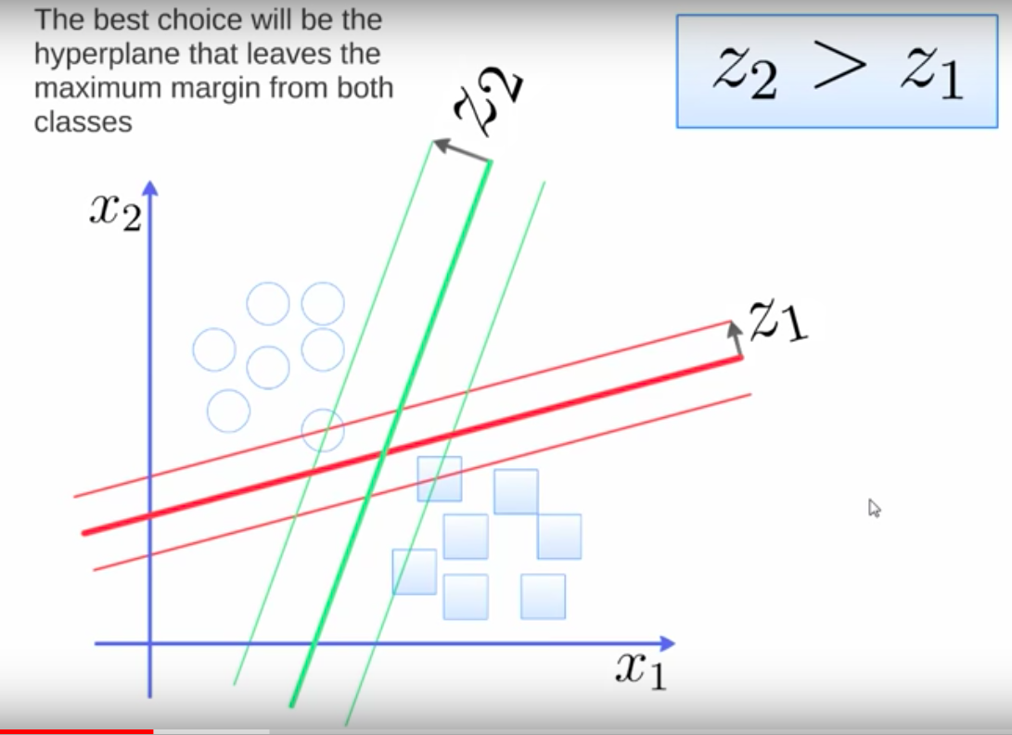
SVM Visualization

Slide 16
Data Pre-Processing: Scaling
Ensures that the scales of each feature and standard, and one does not contribute more towards the output solely due to its scale.
For applications of Euclidean distance, varying scales in features can distort results.
Standardization (z-score): uses variance, mean and standard normal distribution, and fits it approximately to a bell curve.
Min-Max Scaling (between 0 and 1): (x – min(x)) / (max(x) – min(x), and doesn’t have an expected distribution.

Slide 17
Next steps: https://github.com/kjaisingh/AI-Penn

